Slide 1
Market Place - MVP AWS Serverless Architecture

Slide 2



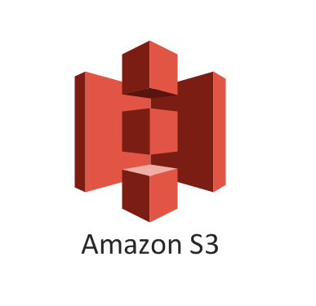













Amazon Route 53
Amazon SQS
AWS Lambda
Atlas MongoDB
MP Clients
Data
Apigee API Gateway
Amazon CloudFront
(CDN)
Amazon API Gateway
AWS Lambda
Amazon SNS
Amazon CloudWatch
Monitoring & Analytics
IAM
Messaging/Workflow
Security
Atlas MongoDB
Cloud Formation
CI/CD
Market Place
7Now
Meta Data (Catalog, Store details, Delivery Providers, settlement file)
Ec2 – Batch Server

Slide 3







AWS Services in Market place
Cloud Front(CDN)
Global Content Delivery Network
CloudWatch
Resource and Application Monitoring
Route 53 -Scalable DNS and Domain Name Registration
CloudFormation
Templated AWS Resource Creation
S3
Scalable storage in the Cloud
SQS
Message Queue Service
API Gateway
Single Point of Entry
SNS
Push Notification Service
Lambda
Run Code in Response to Events
EC2
Virtual Servers in the Cloud
Identity and Access Management
Access Control and Key Management

Slide 4
List of Microservices

Slide 5
MP Store Setup Services (Meta Data)
REST
Catalog Services (Batch & Live)
MP Atlas MongoDB
UserProfile Services
Order Management Services
MP Clients
7Now AWS Lambda
Tax Services
One Source
Payment Services
Market Place
Setup Services : Location Info

Slide 6
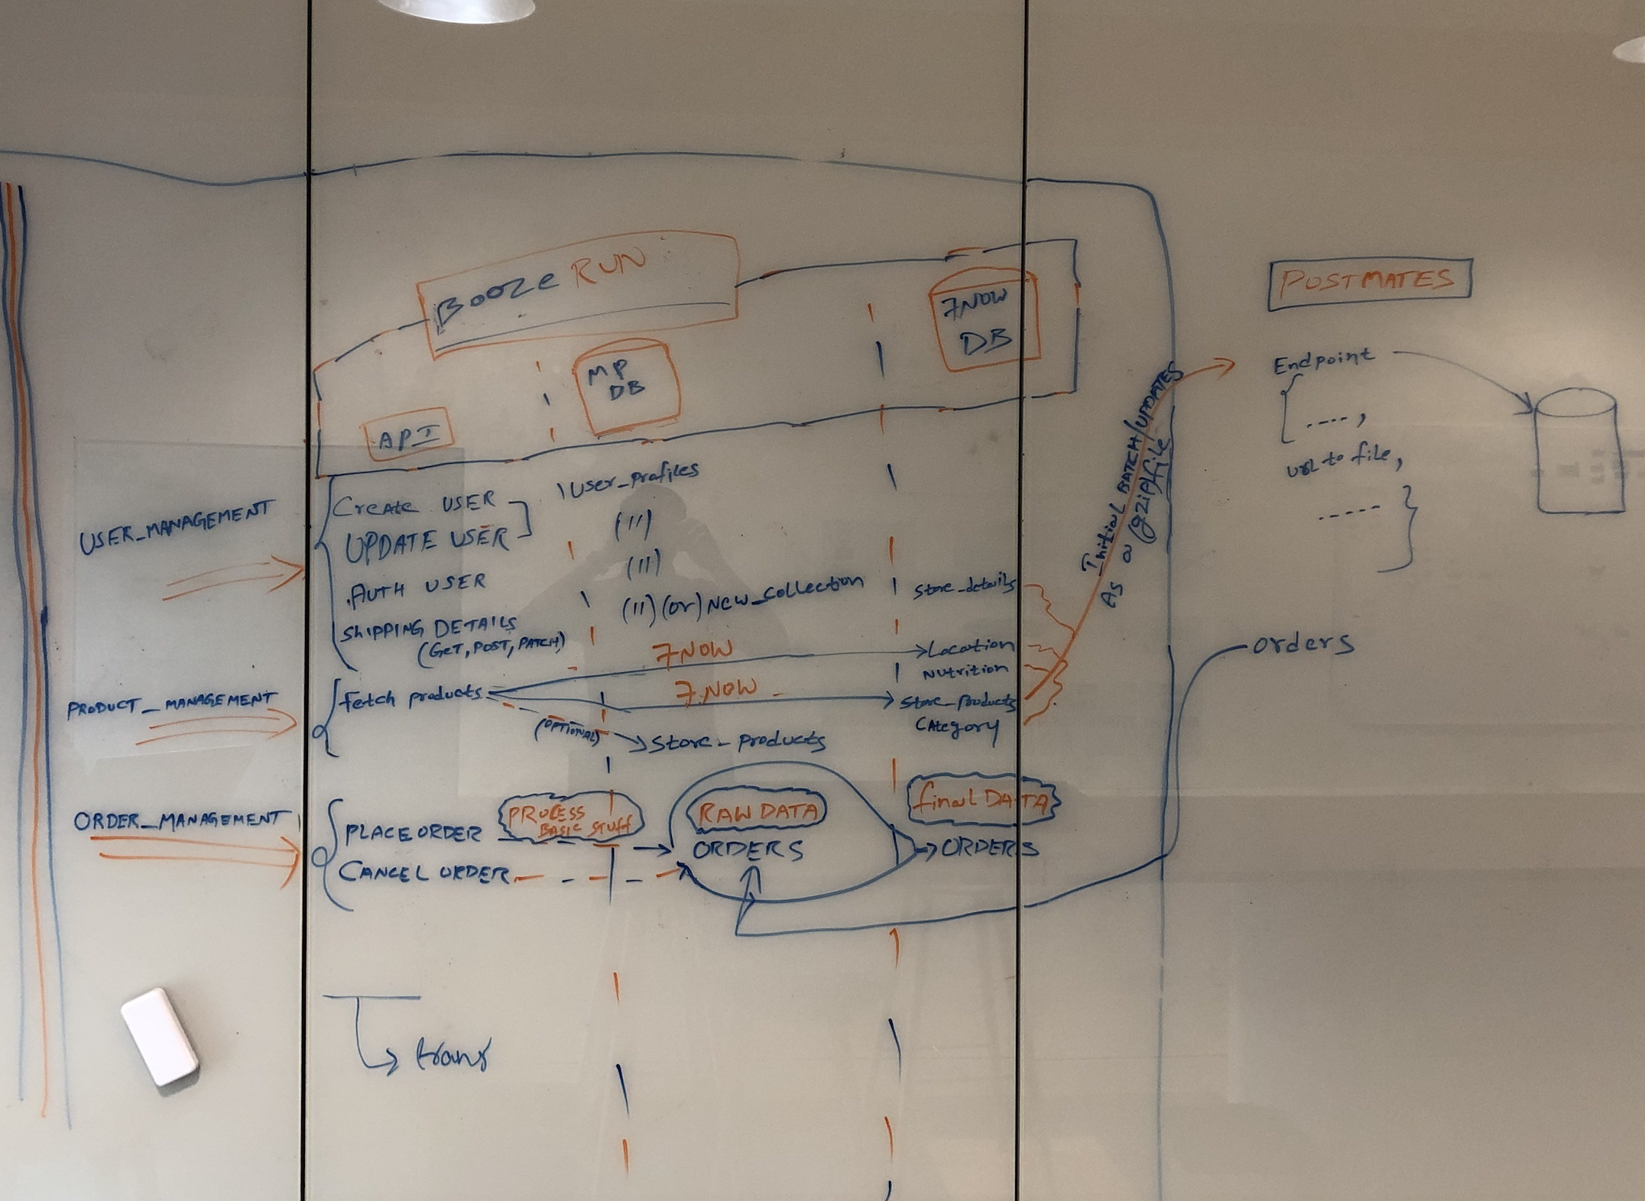

Slide 7
List of Collections in Databases

Slide 8
User Management Orders Raw Data + status Job Sync Status
Inventory
Store Details
Orders Payments
Store Details
Store Products
Market Place
7Now

Slide 9
Questions :
General :
Cancellation of Orders by 7-Eleven Store
Modifiers need to be included with products
Bundles & Vendor funded Promos has to be handled, basket fee
Handling payments
Do we need do age verification for alcohol products
Who does Tax calculations
Technical :
Catalog refresh set up

Slide 10
Google Integration :

Slide 11
Food Ordering
Inventory Feeds
Fulfillment Actions
Restaurant entity
Service entity
Menu entity
Checkout Action
SubmitOrder Action

